Slide 1


Analytical CRM Development for a Bank
Date – 14-09-2026
By – sushant kumar

Slide 2
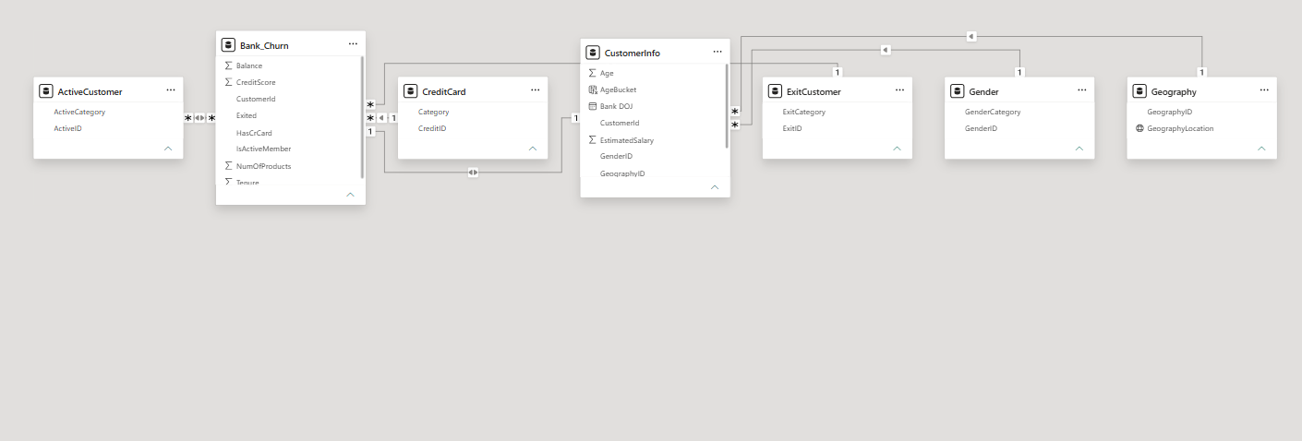
Data schema

Slide 3
Problem Statement
Customer churn is a growing concern, with 20.37% of the bank's 10,000 customers having exited
No unified view exists across customer demographics, transactions, and exit data
Germany shows a disproportionately high churn rate (~32%) despite having the highest-value customers
69% of exited customers held only a single product, pointing to weak cross-sell engagement
Inactive members churn nearly 2x more than active members, but activity data has quality issues
Older and female customers churn at noticeably higher rates, with no clear reason captured in the data
The bank lacks a data-driven way to identify at-risk customers before they leave

Slide 4
Data Description
Dataset covers 10,000 bank customers across 3 countries: France, Germany, Spain
7 related tables: Bank_Churn, CustomerInfo, Geography, Gender, CreditCard, ActiveCustomer, ExitCustomer
Core fields include CreditScore, Balance, Tenure, NumOfProducts, EstimatedSalary, Age
Customer join dates (Bank DOJ) span 2016–2019
Categorical lookup tables define credit card ownership, activity status, and exit status
Data is clean — no missing values found across any table
One data quality issue identified: 735 customers marked both "Exited" and "Active Member" (contradictory)

Slide 5
Objective Key Metrics
Objective: identify why customers churn and flag at-risk customers early to improve retention
Track overall churn rate (currently 20.37%) as the primary success metric
Monitor churn rate by region, gender, age bracket, and product count to find high-risk segments
Measure active vs. inactive member ratio as a leading indicator of engagement
Track average balance and credit score by churn status to gauge financial risk exposure
Use a Churn Risk Score (product count + activity + credit score) to rank customers by risk
Target: reduce overall churn rate below 15% through targeted retention actions

Slide 6
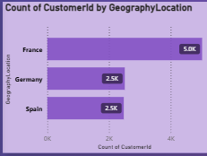
Customer Distribution by Geography
• France leads with 5.0K customers.
• Germany has 2.5K customers.
• Spain also has 2.5K customers.
• France has twice as many customers as Germany or Spain.

Slide 7
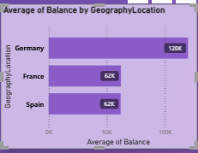
Average Balance by Geography
Germany has the highest average balance at 120K.
France has an average balance of 62K.
Spain also has an average balance of 62K.
Germany’s average balance is nearly twice that of France and Spain.

Slide 8
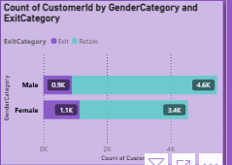
Customer Distribution by Gender and Exit Status
Male: 4.6K retained vs. 0.9K exited.
Female: 3.4K retained vs. 1.1K exited.
Male customers have higher retention overall.
Female customers have a slightly higher exit count.

Slide 9
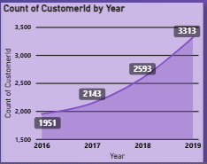
Customer Growth Trend (2016–2019)
Customer count increased every year.
2016 recorded 1,951 customers.
Customers grew to 2,593 in 2018.
2019 reached the highest count at 3,313 customers.

Slide 10
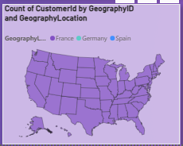
Customer Distribution by Geography
Customers are distributed across multiple geographic regions.
France, Germany, and Spain are represented in the dataset.
The map highlights the geographic spread of customers.
Customer locations are concentrated across the United States map area.

Slide 11
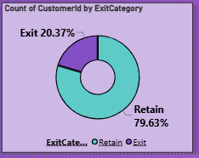
Customer Retention vs Exit Analysis
79.63% of customers were retained.
20.37% of customers exited.
Retention is significantly higher than customer exit.
The chart shows a strong customer retention rate.

Slide 12
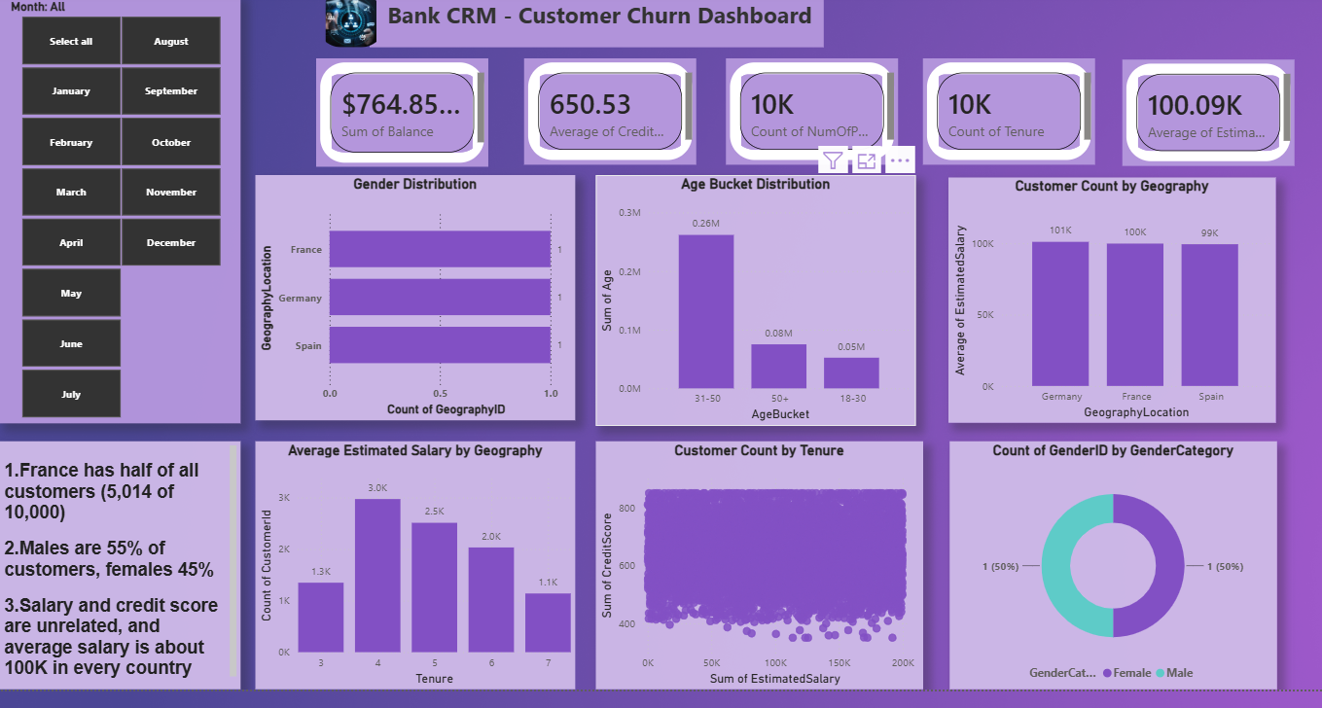
Customer Demographics Dashboard

Slide 13
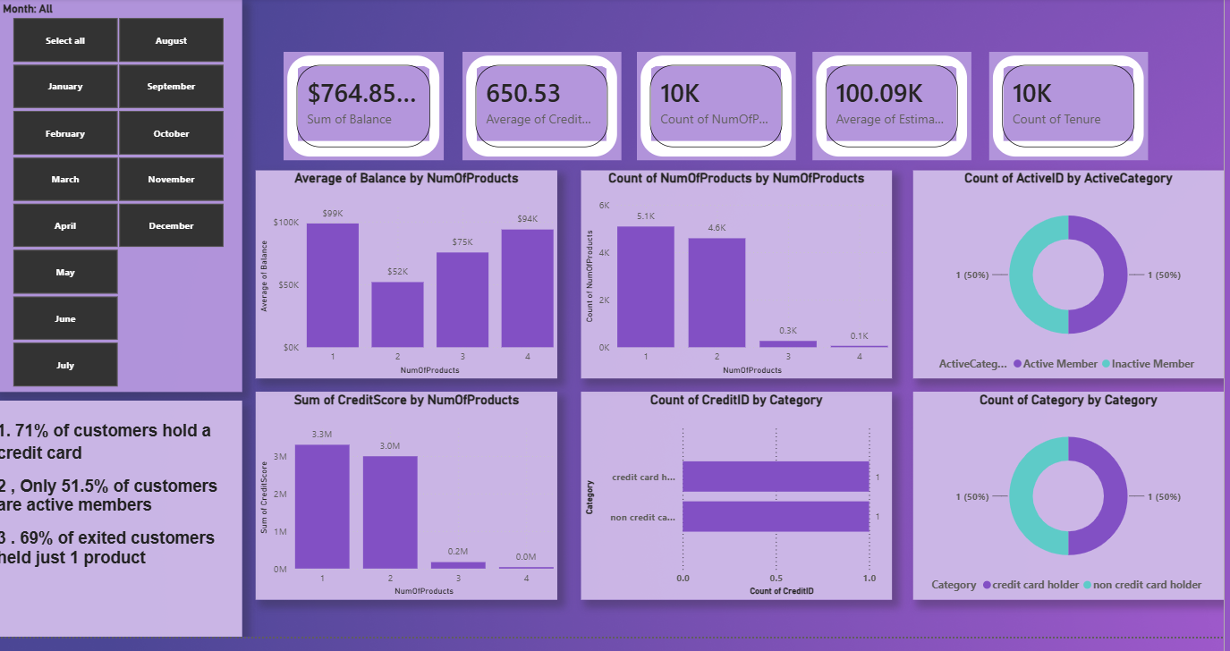
Product Engagement Dashboard

Slide 14
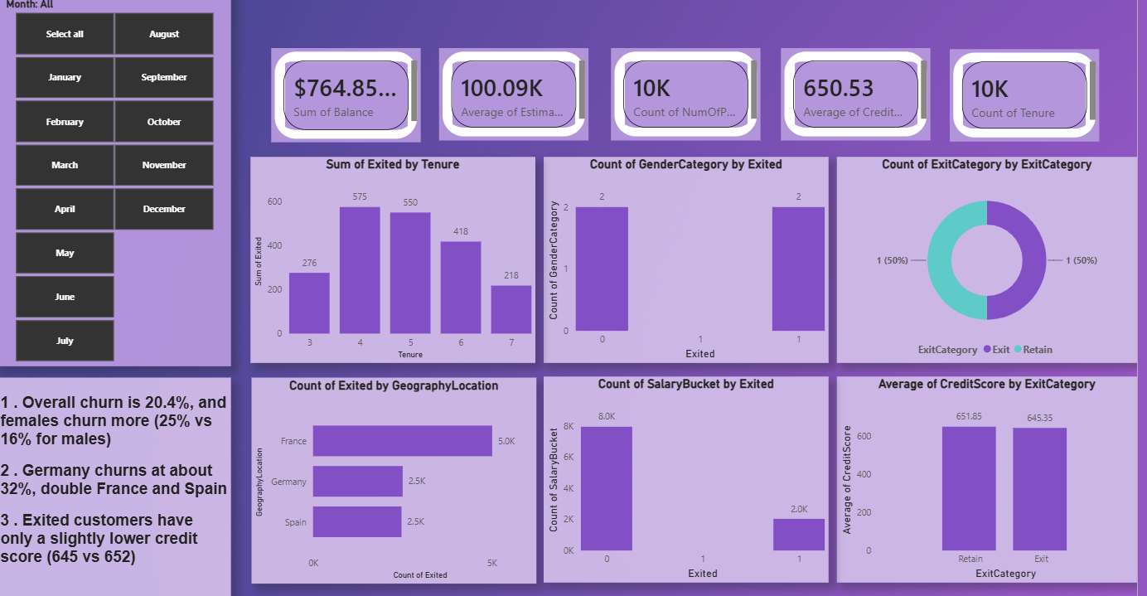
Churn Analysis Dashbord

Slide 15
Conclusion
Overall churn stands at 20.37%, remaining stable at 19–22% across all four years
Germany is the biggest risk — highest churn (~32%) combined with the highest average balances
Single-product customers are the largest churn group, making up 69% of all exits
Inactive members churn ~2x more than active members (26.85% vs 14.27%)
Salary, credit score, and tenure showed weak or no predictive power for churn
Key recommendation: cross-sell a second product and launch re-engagement campaigns for inactive customers
Fix the 735-record data quality issue before building any predictive churn model

Slide 16
Key Recommendations
Cross-sell aggressively to single-product customers — the single biggest retention lever available
Launch re-engagement campaigns targeting inactive members before they churn
Prioritize Germany with a dedicated retention strategy — investigate local service, pricing, or competitor issues
Deploy the Churn Risk Score to flag high-risk customers for proactive outreach
Build tailored offers for older (45+) and female customers, both showing consistently higher churn
Correct the 735 mislabeled records before any predictive modeling work begins
Track churn monthly through the dashboard rather than reviewing it retrospectively

